Slide 1
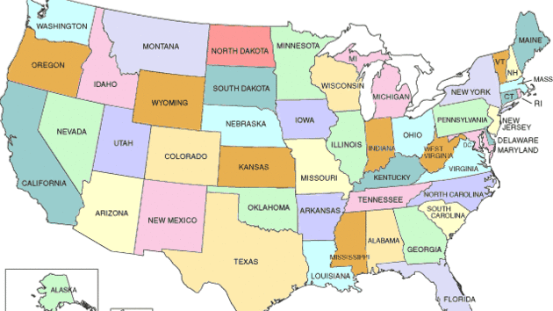
Pennsylvania
Glazkova Daria, 11 «A»

Slide 2
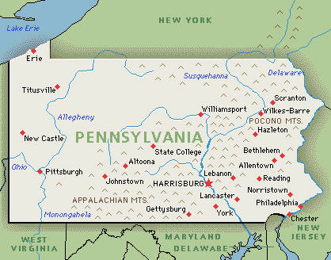
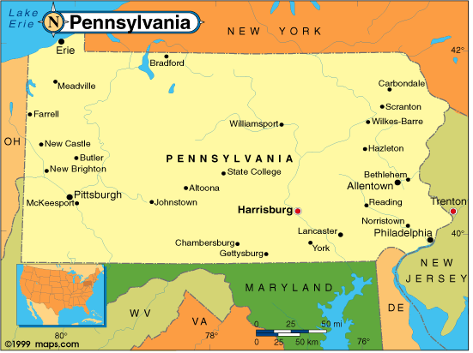
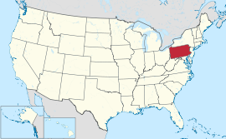
Pennsylvania is a U.S. state.
Pennsylvania, officially the Commonwealth of Pennsylvania, is a U.S. state that is located in the Northeastern and Mid-Atlantic regions of the United States, and the Great Lakes Region. The state borders Delaware and Maryland to the south, West Virginia to the southwest, Ohio to the west, New York and Ontario, Canada, to the north, and New Jersey to the east. Pennsylvania is the 33rd most extensive, the 6th most populous, and the 9th most densely populated of the 50 United States. The state's four most populous cities are Philadelphia, Pittsburgh, Allentown and Erie. The state capital is Harrisburg. Pennsylvania has 51 miles (82 km) of shoreline along Lake Erie and 57 miles (92 km) of shoreline along the Delaware Estuary.

Slide 3
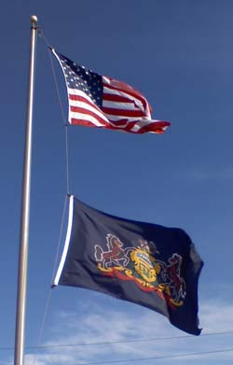
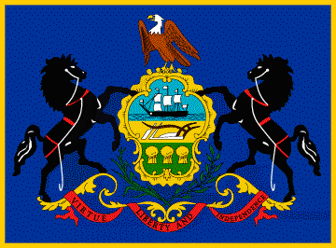
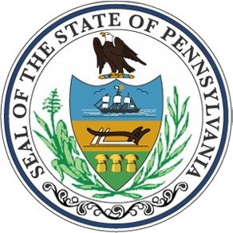
History of Pennsylvania
The first European settlers in what is now Pennsylvania were the Swedes and Dutch. In 1681 English King Charles II gave young English Quaker William Penn a large area west of the Delaware River. In honor of Father Penn, Admiral of the Royal Navy, the colony was called Pennsylvania. Pennsylvania - in Latin, Penn Sylvania - Wooded land of Penn. In 1751 Pennsylvania opened the first British colony in the hospital, and also founded the first university - the University of Pennsylvania. In 1790, Pennsylvania became the first North American states adopted the law on the Emancipation Proclamation. Pennsylvania has actively participated in the war for independence. In 1776 the Constitution was adopted the Commonwealth of Pennsylvania (the official name of State). At the same time in Philadelphia, the Second Continental Congress proclaimed the Declaration of Independence and Pennsylvania, along with twelve other former North American colonies of Great Britain, formed the United States. In the Civil War, Pennsylvania was on the side of the "northerners.“
Pennsylvania state flag.
State Motto: «Virtue, liberty and independence».
American abbreviation for the state – RA.

Slide 4
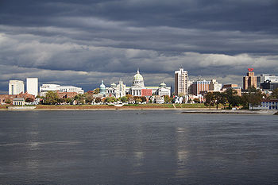
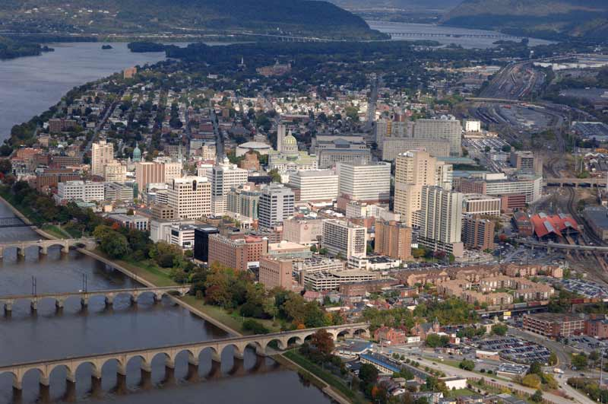
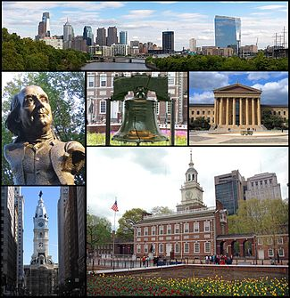
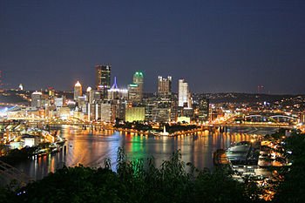
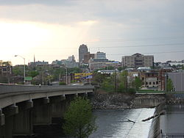
The capital of Pennsylvania.
Harrisburg - capital of the U.S. state of Pennsylvania and the administrative center of Dauphin County, on the Susquehanna River, at 169 miles west of Philadelphia.
The state's four most populous cities are Philadelphia, Pittsburgh, Allentown and Erie.

Slide 5
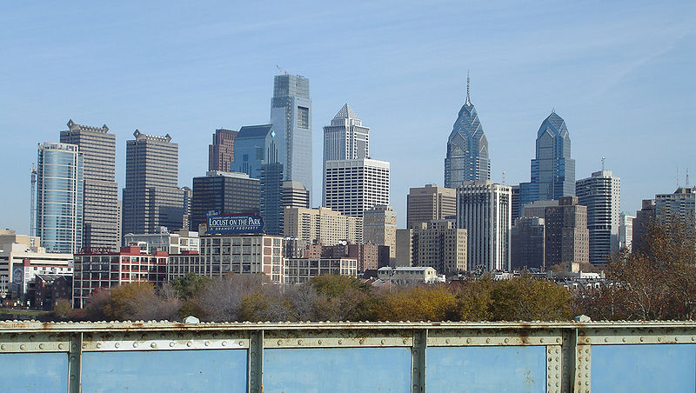
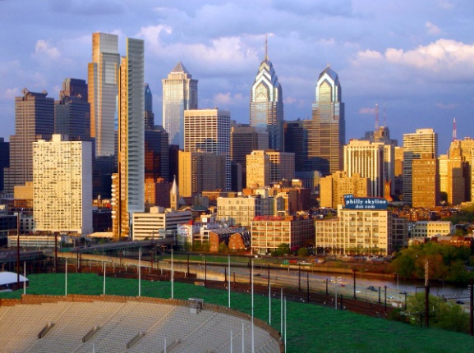
Features.
Pennsylvania was the first in many respects in the life of the young American nation. It was in Philadelphia, Pennsylvania, appeared, the first American daily newspaper, the first paper mill, the first American bank, the first steamboat, the first social hospital. Another feature of the state is the height of buildings in the city of Philadelphia, which is strictly regulated by law.
As in Washington should not be higher than the Capitol buildings, and in Philadelphia forbidden to erect skyscrapers in the city. The aristocracy of the city still prefers to live in the center of the mansion.

Slide 6
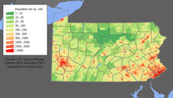
Population.
The population of Pennsylvania is 12604767 people. Geographically, the center of population is located in Perry County Dankennon. Among the residents of Pennsylvania about 36% - came from Asia, 35.9% - from Europe, 30.6% - from Latin America, 5% - from Africa, 3.1% - from North America, 0.4% - from Oceania. Recently, a lot of people coming from Latin America. Most Latin Americans - roughly 85% - is concentrated around the city of Philadelphia, and about 20% - live in it.
In terms of age, residents of Pennsylvania - 5.9% of the population is under 5 years old, 23.8% - up to 18 years, 15.6% - 65 years of age or older. In its origin pensilvantsy: 28.5% - the Germans, 18.2% - the Irish, 12.8% - the Italians, by 8.5% - the British, 7.2% - Poles, 1.9% - the French, by 4.3% - the Americans, by 4.2% -the French-Canadians, by 2.2% - the Dutch, by 2% - Slovaks, 2% - the Scots-Irish,1.6% - Russian at 1.5% - came from Wales, at 1.2% - the Hungarians, by 1% -Ukrainians.

Slide 7
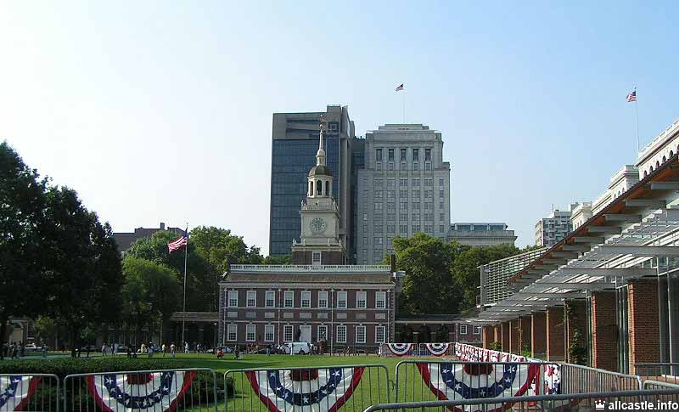
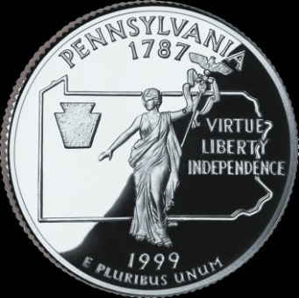
Economy.
Pennsylvania is in 4th place in the U.S. coal mining. In this case it is located in Pennsylvania's largest deposit of coal-anthracite. Among other minerals, which is rich in Pennsylvania, peat, limestone, gravel and oil. In 1859 in Pennsylvania, drilled the first commercial oil well, so that the staff in this area - a pioneer. There are also many machine-tool factories and enterprises that are engaged in metal processing and production of transport equipment.
In Pennsylvania, a well-developed food processing industry, which works using local agriculture. In the south-eastern state of peaches and apples are grown in the coastal zone of Lake Erie - broken cherry orchards and vineyards. Back in Pennsylvania cultivated a high-quality tobacco, which is used for the production of cigars. Among other popular crops - wheat, buckwheat, and dairy farming predominant direction.

Slide 8
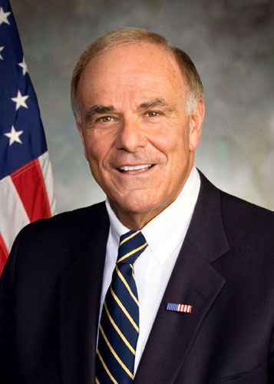
Politics.
Governor: Tom Corbett.
Pennsylvania has the official status of a state governed by a bicameral legislature, which includes 50 members of parliament are elected every four years, and 203members of the House of Representatives, elected, in turn, every two years. Since the 1950s, Democratic and Republican parties are represented in roughly equal proportions. The governor is elected for a four-year term and may be reelected at the end of the period only once. The judicial branch is headed by the Supreme Court, which represent the Chief Justice and six members of the court, all of whom are elected for a term of ten years. At the local level, Pennsylvania has 66 counties, each of which is controlled by three justices of the peace.

Slide 9
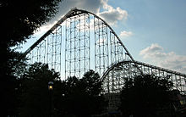
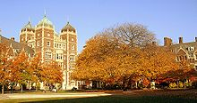
Recreation.
Pennsylvania is home to the nation's first zoo, the Philadelphia Zoo. Other long-accredited AZA zoos include the Erie Zoo and the Pittsburgh Zoo & PPG Aquarium. The Lehigh Valley Zoo and ZOOAMERICA are other notable zoos. The Commonwealth boasts some of the finest museums in the country, including the Carnegie Museums in Pittsburgh, the Philadelphia Museum of Art, and several others. One unique museum is the Houdini Museum in Scranton, the only building in the world devoted to the legendary magician. Pennsylvania is also home to the National Aviary, located in Pittsburgh.
All 121 state parks in Pennsylvania feature free admission.
Pennsylvania offers a number of notable amusement parks, including Camel Beach, Conneaut Lake Park, Dorney Park & Wildwater Kingdom, Dutch Wonderland, DelGrosso Amusement Park, Hersheypark, Idlewild Park, Kennywood, Knoebels, Lakemont Park, Sandcastle Waterpark, Sesame Place, Great Wolf Lodge and Waldameer Park. Pennsylvania also is home to the largest indoor waterpark resort on the East Coast, Splash Lagoon in Erie.
There are also notable music festivals that take place in Pennsylvania. These include Musikfest and NEARfest in Bethlehem, the Philadelphia Folk Festival, Creation Festival, the Great Allentown Fair, and Purple Door.

Slide 10
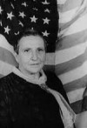
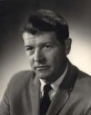
Famous people of Pennsylvania.
Gertrude Stein - a famous American writer.
Mari Cassatt. The famous American graphic artist and painter who wrote in the style of impressionism.
Andrew Wyeth. Famous American artist - a realist of the twentieth century.
Wilton Norman Chamberlain, one of the greatest pivot ever coming out on thebasketball court.
James Lightbodi. American athlete, triple champion of Olympic Games 1904.
Solomon Burke. American singer and songwriter, Grammy Award winner.
Kristian Anfinsen - the famous American scientist, a biochemist.

Slide 11
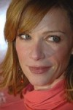
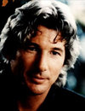
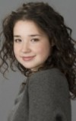
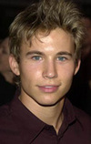
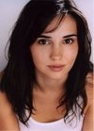
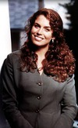
Taylor Swift. Popular singer, performing pop music.
Lauren Holly - a famous American actress.
Richard Gere.
Sarah Steele. American film actress and TV series.
Jonathan Taylor Thomas - American actor.
Laura Breckenridge - American actress.
Megan Gallagher - American actress.

Slide 12
Actors:
F. Murray Abraham—Pittsburgh
Gerald Anthony—Pittsburgh
Val Avery—Philadelphia
Kevin Bacon—Philadelphia
Carroll Baker—Johnstown
Chris Barnes—Scranton
Vince Barnett—Pittsburgh
Ethel Barrymore—Philadelphia
John Barrymore—Philadelphia
Lionel Barrymore—Philadelphia
Jayce Bartok—Pittsburgh
Billy Barty—Fredericktown-Millsboro
Blake Bashoff—Philadelphia
Alan Beckwith—Tyrone
Maria Bello—Norristown
Radio and television
Rick Amato, radio talk show host, conservative commentator, columnist—Pittsburgh
Jodi Applegate, broadcast journalist—Moon Township
Chuck Barris, television host and producer—Philadelphia
Astronauts:
Guion S. Bluford, astronaut, first African-American man in space—Philadelphia
Pete Conrad, Gemini, Apollo, and Skylab astronaut, third man to walk on the Moon—Philadelphia
Michael Fincke—Pittsburgh
Athletes:
Stan Belinda, professional baseball player—Huntingdon
Brad Benson, professional football player—Altoona
Fred Biletnikoff, professional football player—Erie
Steve Bilko, professional baseball player—Nanticoke
Steve Blackman, professional wrestler—Annville
Musicians:
Christina Aguilera— Pittsburgh
Akron/Family— Williamsport
Kellee Maize- Pittsburgh
Marian Anderson—Philadelphia
Anti-Flag—Pittsburgh
August Burns Red—Lancaster
Frankie Avalon—Philadelphia
Franny Beecher—Norristown
George Benson—Pittsburgh
Benjamin Burnley-Wilkes Barre

Slide 13
